Slide 1
恶意代码分析与防治技术 第5章 基本动态分析
王志
zwang@nankai.edu.cn
南开大学 网络空间安全学院
2023-2024学年

Slide 2
知识点
基本动态分析
沙箱（Sandbox）
DLL的动态分析
难点：动态链接库的启动，服务程序的启动
进程动态监控
注册表动态监控 Regshot
网络动态监控
重点：Process Monitor、Process Explorer、Regshot、Wireshark

Slide 3
基本动态分析 Basic Dynamic Analysis

Slide 4

主观题
10分
已经可以提取静态特征并基于Yara引擎开发杀毒软件，为什么还需要动态分析？
作答

Slide 5
为什么要进行动态分析
Static analysis can reach a dead-end, due to
Obfuscation
Packing
Examiner has exhausted the available static analysis techniques
Dynamic analysis is efficient and will show you exactly what the malware does
Notes:
Dynamic analysis techniques are the second step in the malware analysis process.
Perform after static analysis.
change the syntactic format and prevent the semantic mean, packing: compress and encrypt
Run the malware and observer its behaviors to understand the malware functionality.
Different arguments could execute different program functionality.
Challenge is how to force malware to execute all of its functionality.

Slide 6
多选题
10分
以下哪项可以用来隐藏程序中的字符串信息？
A
UPX
B
PEiD
C
ELF
D
DLL
提交

Slide 7
沙箱 Sandboxes: The Quick-and-Dirty Approach

Slide 8
沙箱
All-in-one software for basic dynamic analysis
Virtualized environment that simulates network services
Examples: Norman Sandbox, GFI Sandbox, Anubis, Joe Sandbox, ThreatExpert, BitBlaze, Comodo Instant Malware Analysis
They are expensive but easy to use
They produce a nice PDF report of results
Notes:
all-in-one;一体化的， not only simulates system calls but also have to simulates network services.

Slide 9
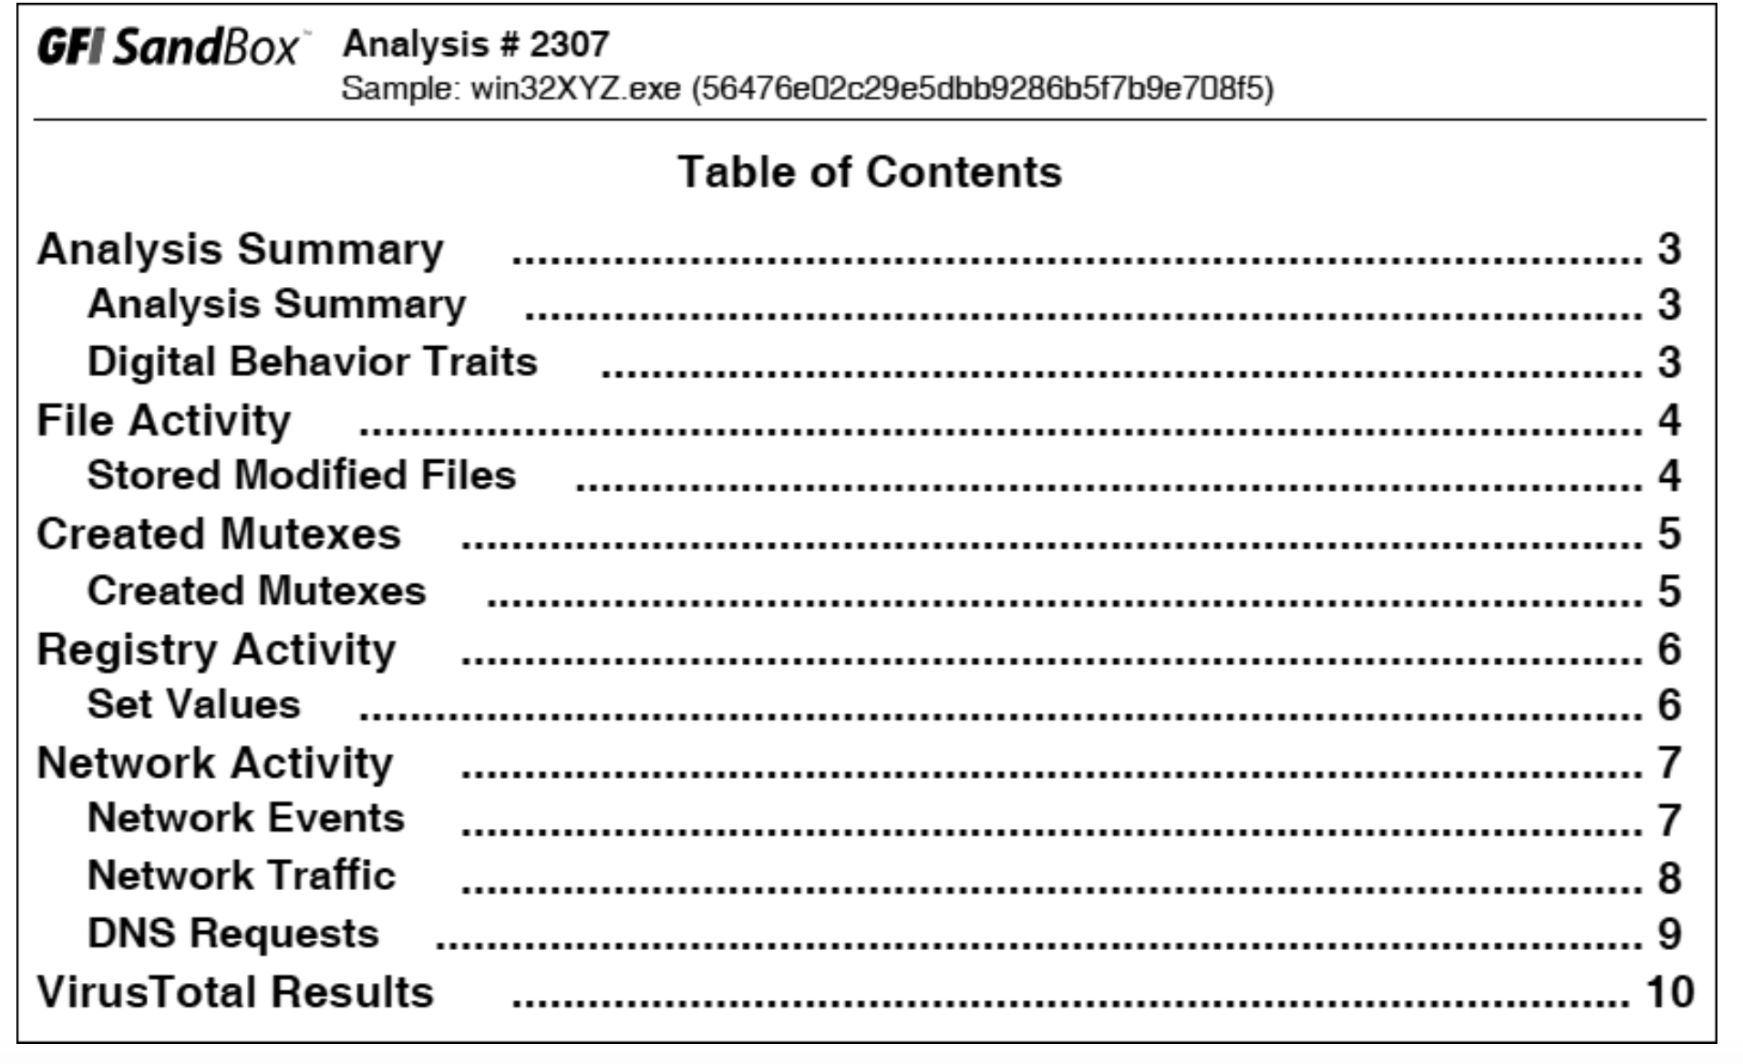
Notes:
6 sections:

Slide 10
主观题
10分
有了沙箱的动态分析结果，计算机病毒还需要进行人工分析吗？
作答

Slide 11
沙箱
缺少命令交互
Without command-line options
Botnet C&C packets
分析时间限制
Not record all events
Stalling behaviors
反虚拟机技术
Anti-VM techniques
运行环境单一
Certain Environment

Slide 12
多选题
10分
沙箱的优点？
A
No command-line options
B
All-in-one software for basic dynamic analysis
C
Not record all events
D
Fixed Environment
提交

Slide 13
多选题
10分
沙箱的缺点有哪些？
此题未设置答案，请点击右侧设置按钮
A
缺少命令交互
B
分析时间限制
C
反虚拟机技术
D
运行环境单一
提交

Slide 14
动态链接库程序的动态分析 Launching DLLs

Slide 15
主观题
10分
如何动态分析一个动态链接库程序？
作答

Slide 16
动态链接库程序的执行
EXE files can be run directly, but DLLs can't
Use rundll32.exe (included in Windows)
rundll32.exe DLLname, Export arguments
The Export value is one of the exported functions you found in Dependency Walker, PEview, or PE Explorer.
Notes:
We know how to run executables that just double click it. There are a lot of functions but no main function

Slide 17
动态连接库程序的执行
Example
rip.dll has these exports: Install and Uninstall
rundll32.exe rip.dll, Install
Some functions use ordinal values instead of names, like
rundll32.exe xyzzy.dll, #5
It's also possible to modify the PE header and convert a DLL into an EXE

Slide 18
服务的安装和启动
Installed as a service
rpr32x.dll has the export: InstallService
安装服务
rundll32 ipr32x.dll, InstallService ServiceName
启动服务
net start ServiceName

Slide 19
主观题
10分
Windows的服务程序和应用程序有哪些区别？
作答

Slide 20
服务与应用的区别
功能：通常提供后台运行的长期服务
网络服务、数据备份等
用户交互：一般不与用户直接交互，在后台默默地运行。
权限：通常以系统管理员权限运行，可以访问系统的各种资源。
应用程序则以普通用户权限运行，只能访问其所需的资源和文件。
生命周期：通常在系统启动时启动，直到系统关闭或该手动停止
应用程序则由用户启动和关闭，生命周期由用户控制。
运行模式：服务程序通常以后台进程的形式运行，对用户不可见
应用程序则以前台进程运行，提供给用户可见的界面和操作。

Slide 21
多选题
10分
如何启动服务？
A
net start ServiceName
B
rundll32.exe abc.dll #num arguments
C
rundll32.exe abc.dll function arguments
D
rundll32.exe abc.dll InstallService ServiceName
提交

Slide 22
进程的动态监控

Slide 23
主观题
10分
哪些进程的行为可以进行动态监控？
作答

Slide 24
Process Monitor
Monitors registry, file system, network, process, and thread activity
All recorded events are kept, but you can filter the display to make it easier to find items of interest

Slide 25
Process Monitor
Don't run it too long or it will fill up all RAM and crash the machine
Use RAM to log events until it is told to stop capturing
run out memory to crash the system
limited periods of time
File->Capture Events
File->Clear Display
Notes:
Stop capturing,
Clear irrelevant data on the screen

Slide 26
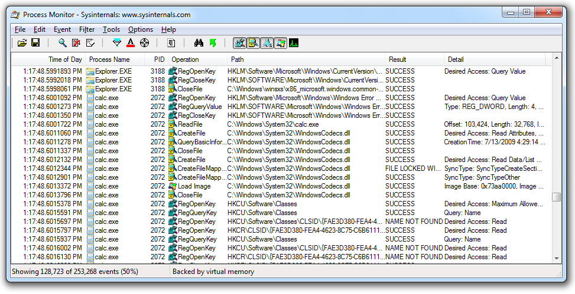
Launching Calc.exe

Slide 27
Process Monitor Toolbar
Default Filters
Registry, File system, Network, Processes
Start/Stop
Capture
Erase
Filter
Notes:
magnifier,

Slide 28
Filtering with Exclude
One technique: hide normal activity before launching malware
Filter on process name
Filter on system calls
Right-click each Process Name and click Exclude

Slide 29
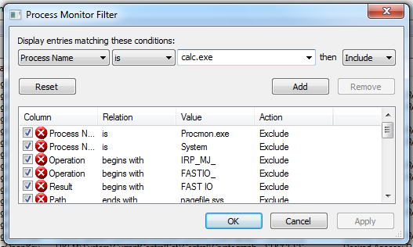
Filtering with Include
Most useful filters: Process Name, Operation, and Detail

Slide 30
多选题
10分
Process Monitor可以动态监控哪些进程的操作行为?
A
Registry
B
File system
C
Network
D
Process
E
Thread
提交

Slide 31
Process Explorer

Slide 32
主观题
10分
进程和进程之间有哪些行为需要进行监控？
作答

Slide 33
Process Explorer
List all processes currently running on the system
Dlls loaded
Various process properties
Overall system information

Slide 34
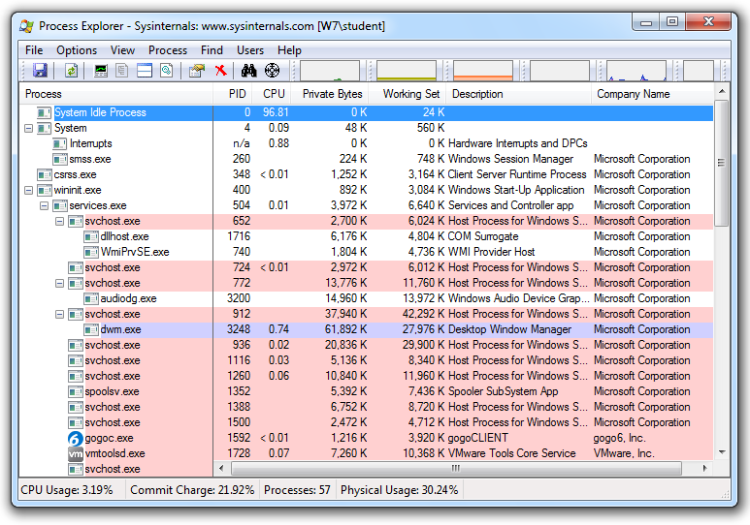
Notes:
Free from Microsoft
provide valuable insight into the processes currently running on a system
list active processes in a tree structure that displays child and parent relationship
Service is highlighted in pink, processes in blue, new processes in green, and terminated processes in red.

Slide 35
Coloring
Services are pink
Processes are blue
New processes are green briefly
Terminated processes are red

Slide 36
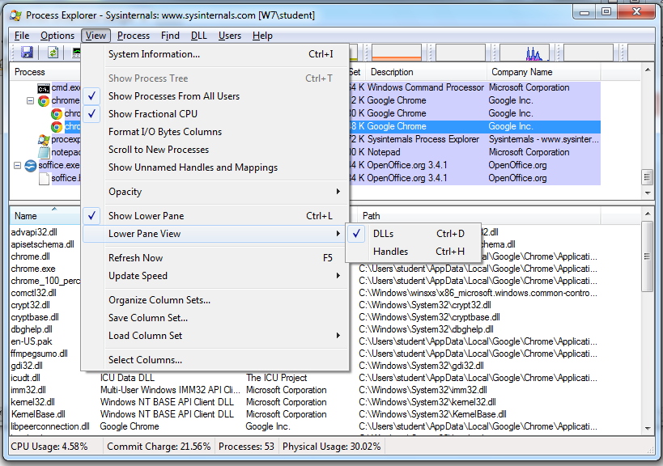
DLL Mode
Notes:
We can see all dlls loaded into memory.

Slide 37
Handle Mode
Notes:
Shows all handles held by the process, include file handles, mutexes, events, directories, and so on.

Slide 38
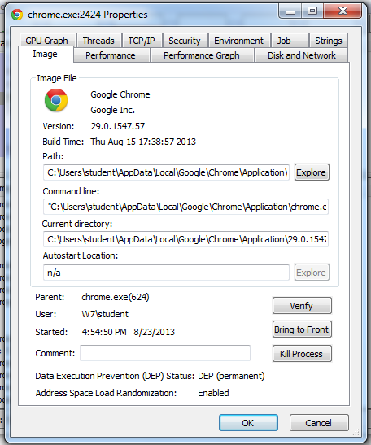
Properties
Shows DEP and ASLR status
Verify button checks the disk file's Windows signature
But not the RAM image, so it won't detect process replacement
Notes:
进程的替换，just check disk file not the codes in memory.
Microsoft uses digital signatures for most of its core executables.
The file is actually the executable from microsoft.
It verifies files on disk rather than images in memory.
Process replacement: overwriting a normal process memory space with malicious codes
The image in memory is different from the image in disk.
DEP: Data Execution Prevension

Slide 39
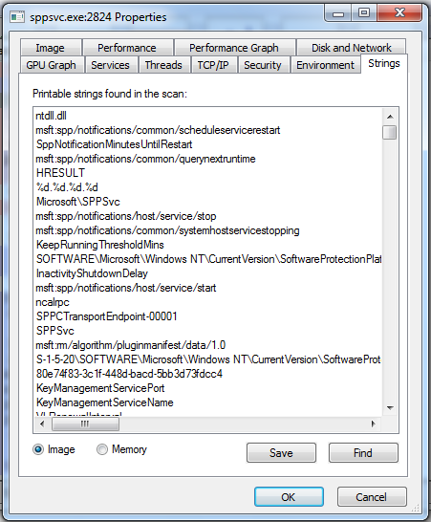
Strings
Compare Image to Memory strings, if they are very different, it can indicate process replacement
Notes:
In basic static analysis, we only see strings in disk. Now, we can see stings in memory.

Slide 40
Detecting Malicious Documents
Open the document (e.g. PDF) on a system with a vulnerable application
Watch Process Explorer to see if it launches a process
The Image tab of that process's Properties sheet will show where the malware is

Slide 41
注册表的动态监控

Slide 42
主观题
10分
如何监控恶意代码修改了系统的哪些注册表项？
作答

Slide 43
Regshot
An open source registry comparison tool
Take registry snapshots
Compare two registry snapshots

Slide 44
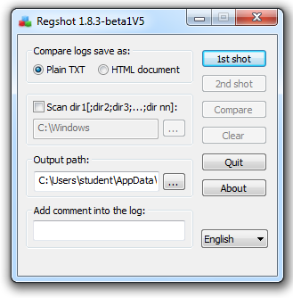

Slide 45
主观题
10分
Windows注册表有哪些功能？
正常使用主观题需2.0以上版本雨课堂
作答

Slide 46
网络动态监控

Slide 47
主观题
10分
计算机病毒分析一般会进行网络隔离，隔离后如何进行网络的动态监控？
作答

Slide 48
Faking a Network
Malware:
beacons out
communicate with a C&C server
Fake Network
obtain network indicators
airgap between VM and Internet
Notes:
We can create a fake network to obtain network indicators without actually connecting to the Internet. These indicators can include DNS names, IP addresses, and packet signatures.
To fake a network successfully, you must prevent malware from realizing that it is executing in a VM.
There are some tools that we can select to setup a fake network to increase our chance of success.

Slide 49
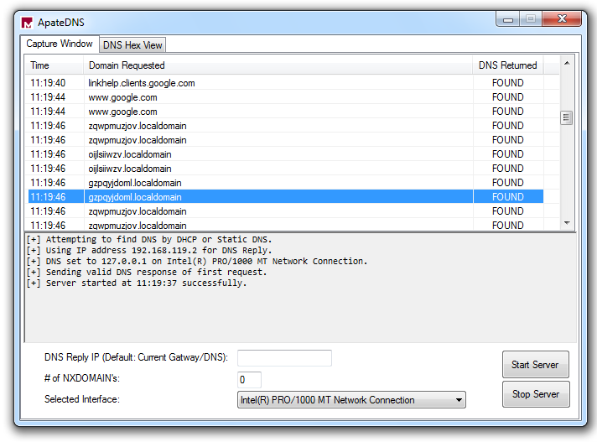
Using ApateDNS to Redirect DNS Resolutions
Notes:
ApateDNS is a free tool. It can capture all DNS requests and spoof DNS responses to a user-specified IP address
We can see the domain requests. As shown in the figure, the request for gzpqydom.localdomain is redircted to ...

Slide 50
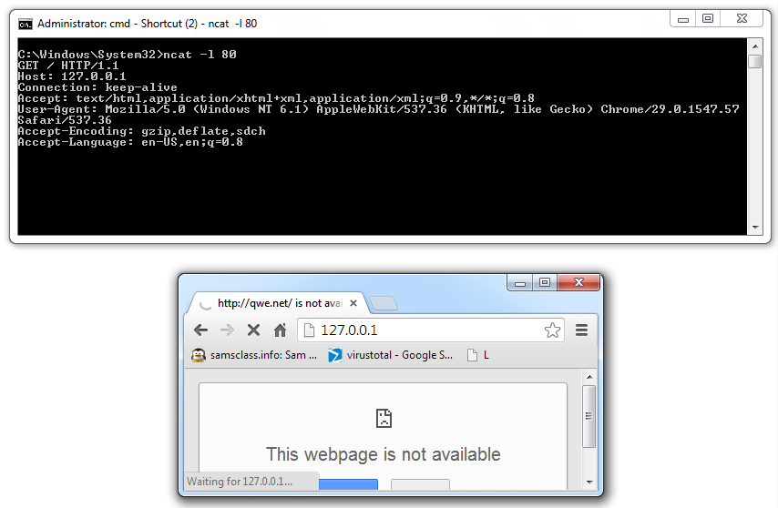
Monitoring with Ncat (included with Nmap)
Notes:
Netcat the TCP/IP Swiss Army Knife.
can be used for inbound and outbound connections for port scanning, proxying, and much more.
Let's look at how to use it to analyze malware.
After DNS redirection, we need nc to listen on the malware http request.
-l flag means listen, 80 is the port number on which to listen

Slide 51
Wireshark
Open source sniffer
capture packets
intercepts and logs network traffic
Understand malware network communication
Chapter 14 discusses protocol analysis and additional uses of Wireshark.

Slide 52
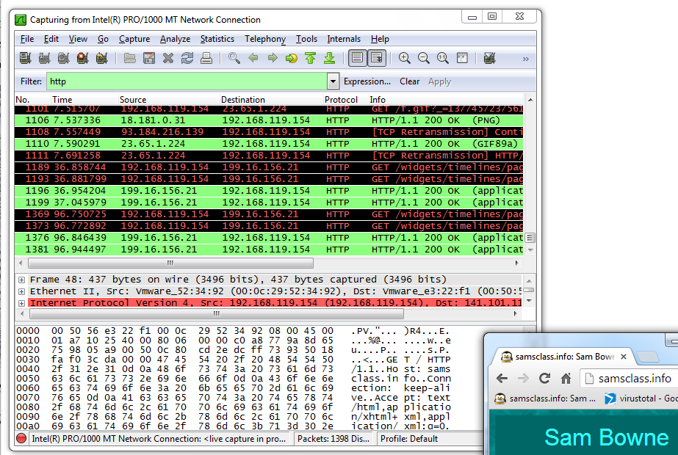
Packet Sniffing with Wireshark
Notes:
Wireshark is a open source sniffer that
captures packets
logs network traffic
provide visualization
packet analysis
filter box, packets listing pane, packet details pane, hexadecimal pane

Slide 53
Follow TCP Stream
Can save files from streams here too
Notes:
We can use wireshark to see a TCP session. right click a packet and select Follow TCP Stream.
cc.nankai.edu.cn

Slide 54
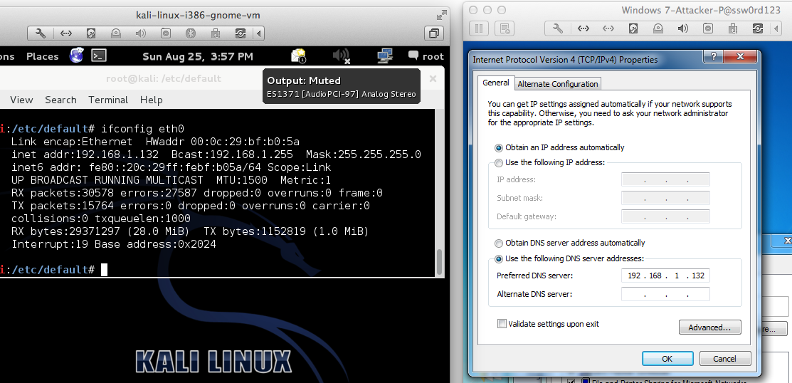
inetsim
Notes:
INetSim is a free, Linux-based software suite for simulating common Internet services.
INetSim can emulate HTTP, HTTPS, FTP, IRC, DNS, SMTP and others.
If malware need a JPEG, response with a properly JPEG file to keep the malware running.

Slide 55
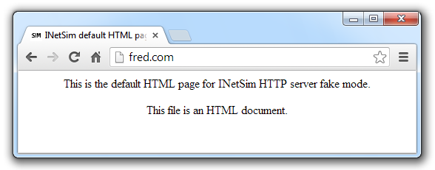
INetSim Fools a Browser
Notes:
The simulated server does not response 404 or other errors, and its response, even if incorrect, can keep the malware running.

Slide 56
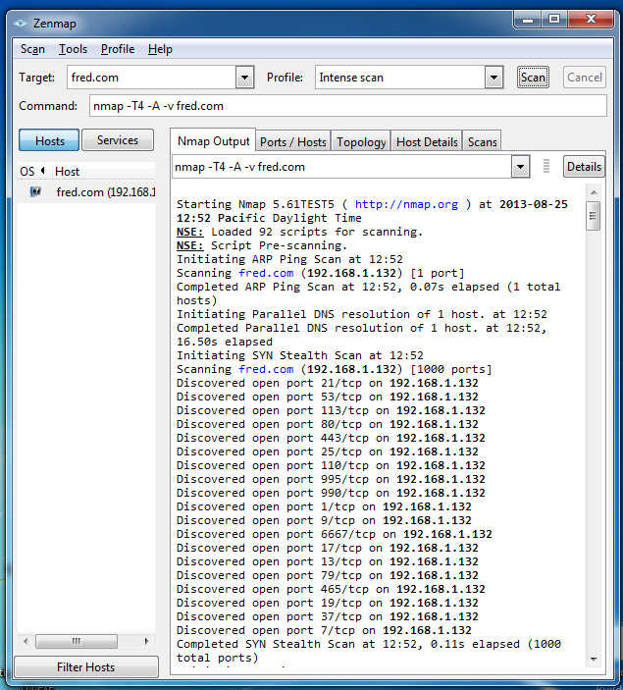
INetSim Fools Nmap

Slide 57
多选题
10分
以下哪些技术可以用于计算机病毒网络行为的动态分析？
A
Sniffing Traffic
B
Simulating Services
C
DNS Spoofing
提交

Slide 58
计算机病毒动态分析实践

Slide 59
Using the Tools
Procmon
Filter on the malware executable name and clear all events just before running it
Process Explorer
Regshot
Virtual Network with INetSim
Wireshark
Notes:
1 run procmon and setting a filter on the malware executable name and clearing out all events just before running
2. Starting process explorer
3. Take registry snapshots
4. set up virtual networks using INetSim
5. Set up network traffic logging using Wireshark

Slide 60
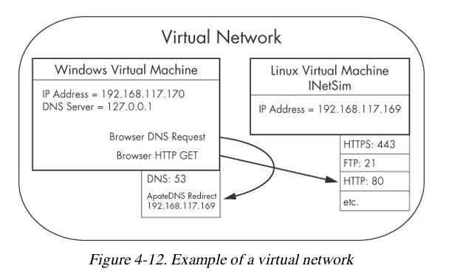
Notes:
Let's look at the diagram of a virtual network we set up for malware analysis.
2 hosts:Windows VM running malware and Linux VM running INetSime
Linux VM listens on many ports including ...
ApateDNS listen DNS request and redirect network traffic to Linux VM

Slide 61
多选题
10分
Which tool reveals the services hosted by scvhost?
A
Procmon
B
Process Explorer
C
Dependency Walker
D
Regshot
E
INetSim
提交

Slide 62
多选题
10分
Which tool is specifically intended to aid analysis of the network traffic from malware?
A
Procmon
B
Process Explorer
C
Dependency Walker
D
Regshot
E
INetSim
提交

Slide 63
Conclusion
Assist and conform basic static analysis findings
Most of tools are free and easy to use
Next chapter is Advanced Static Analysis using reverse engineering.

Slide 64
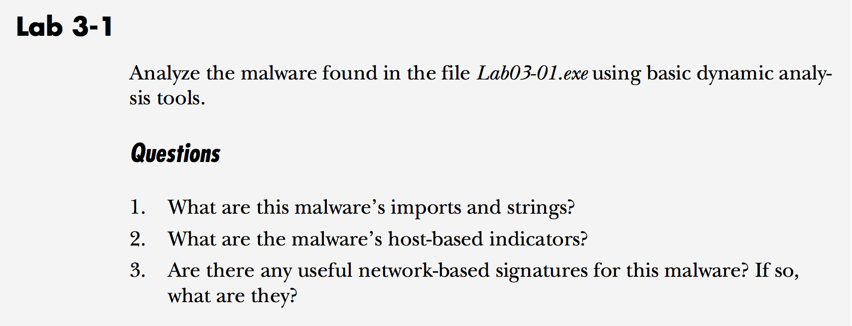
Labs

Slide 65
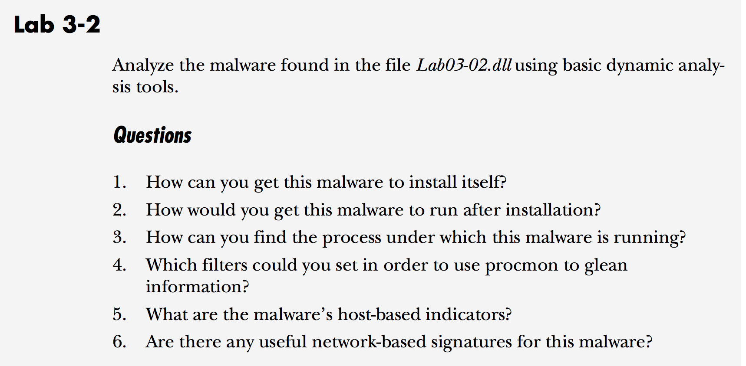
Labs

Slide 66
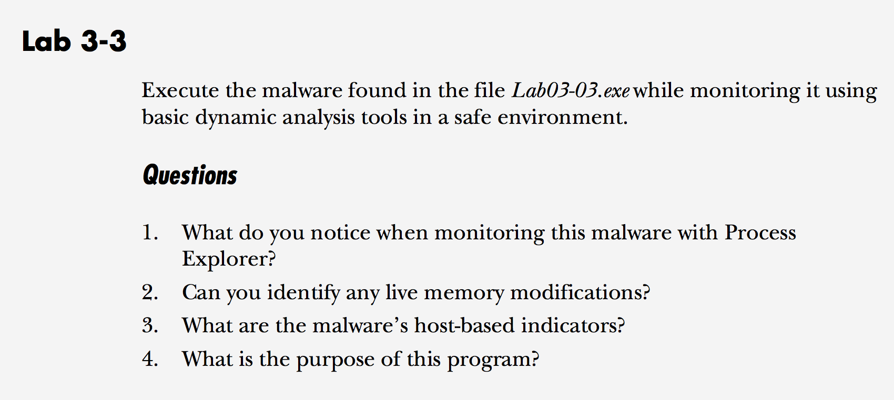
Labs

Slide 67
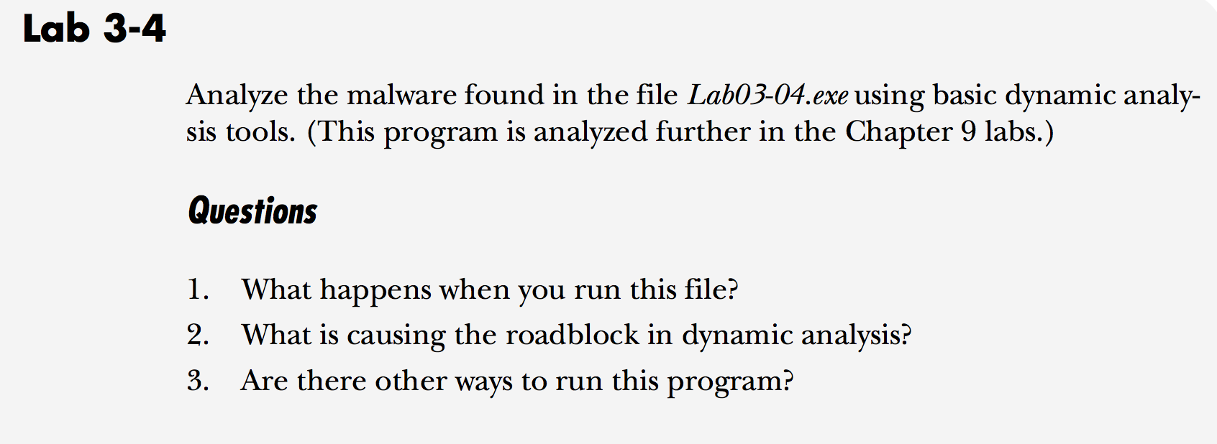
Labs

Slide 68
恶意代码分析与防治技术 第5章 基本动态分析
王志
zwang@nankai.edu.cn
南开大学 网络空间安全学院
2023-2024学年

